Slide 1
Trends and Lessons from Three Years Fighting Malicious Extensions
Nav Jagpal, Eric Dingle, Jean-Philippe, Gravel Panayiotis, Mavrommatis Niels, Provos Moheeb, Abu Rajab, Kurt Thomas
Google
Presenter: Haonan

Slide 2
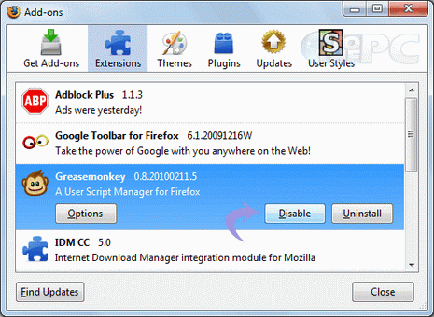
Motivation
Browsers extensions: Add-ons that allow clients to customize their browsing experience by altering the core functionality.
Search toolbars, password managers, ad blockers

Slide 3
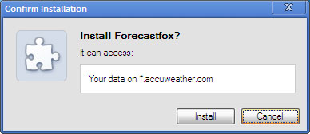
Malicious Extentions
man-in-the-browser attacks:
Facebook account hijackers, ad injectors, and password stealers.

Slide 4
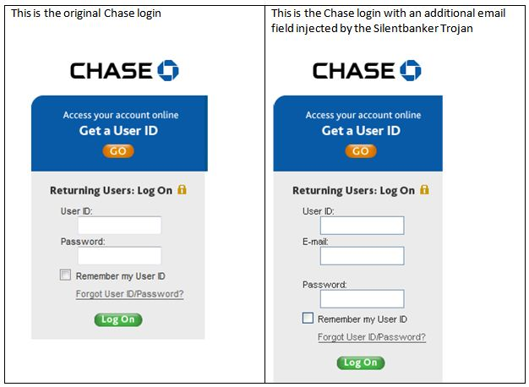
Malicious Extentions
Binary-based:
Torpig banking trojan, ZeroAccess bot.

Slide 5
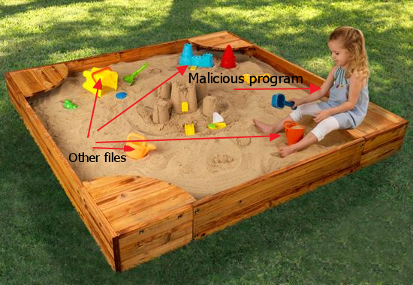
Related Works
Security Sandboxes & Malware Detection
Chrome extensions run in the context of a webpage
Hard for system-wide malware monitoring techniques to isolate malware activity from that of the browser.

Slide 6
WebEval
WebEval is designed to return a verdict for whether an extension is malicious.
If the extension is pending publication, the ChromeWeb Store should block the extension from release.
Previously published extensions must be taken down and uninstalled from all affected Chrome instances.

Slide 7
Design Goals
1. Minimize malware installs.
2. Simplify human verification.
3. Time-constrained.
4. Comprehensible, historical reports.
5. Tolerant to feature drift.

Slide 8
System Flow

Slide 9
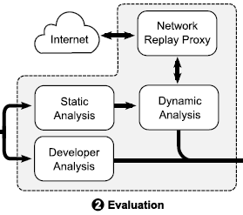
Evaluating Extensions
Static Analysis
Permissions & Content Scripts
Code Obfuscation
Files and Directory Structure
Developer Analysis

Slide 10
Evaluating Extensions
Dynamic Analysis
Outputs:
network requests
DOM operations
Chrome API calls
Sandbox Environment
Behavioral Suites
Generic Suites
Malicious Logic Suites

Slide 11
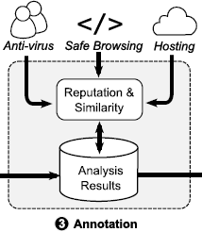
Annotation
Scan all of the files .
Scan outgoing network requests.
Evaluate an extension in the context of all previously scanned extensions.
Cluster the extensions based on the referrer of all incoming install requests.

Slide 12
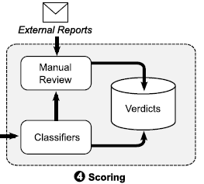
Scoring Extensions
Automated Detection
They train a model daily over all previously scanned extensions with labeled training data originating from human experts.
Any input to the classifier should have a direct translation to an activity that analysts can recognize.
An online gradient descent logistic regression with L1 regularization to reduce the size of feature space.

Slide 13
Scoring Extensions
Manual Rules
Facebook Hijacking
Search Leakage
User Tracking

Slide 14
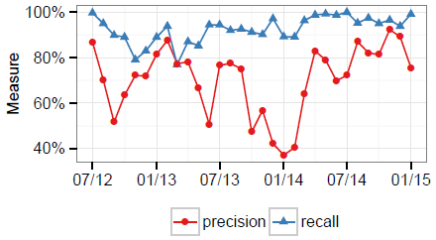
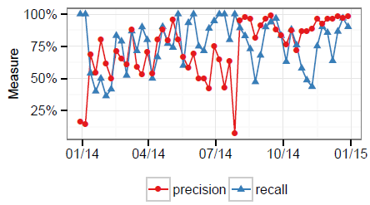
Evaluation
Monthly:
Weekly:

Slide 15
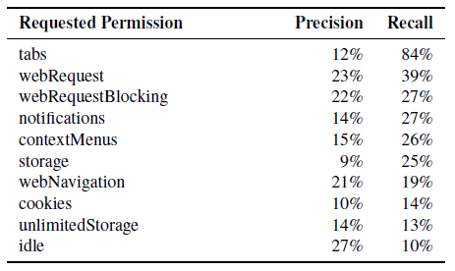
Evaluation
Top 10 permissions requested in extension manifest.

Slide 16
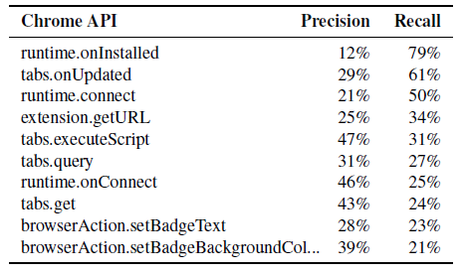
Evaluation
Top 10 Chrome API calls performed during dynamic execution.

Slide 17
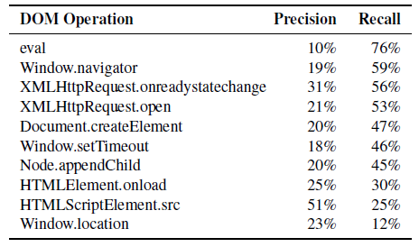
Evaluation
Top 10 DOM operations performed during dynamic execution.

Slide 18
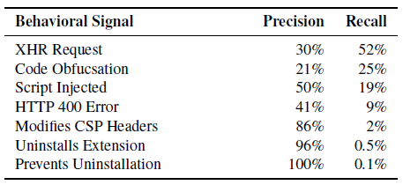
Evaluation
Precision and recall of individual behavioral signatures.

Slide 19
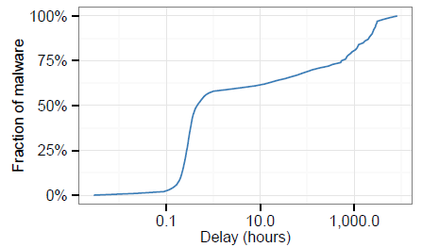
Evaluation
CDF of the delay before catching a malicious extension after it is first submitted to the Chrome Web Store

Slide 20
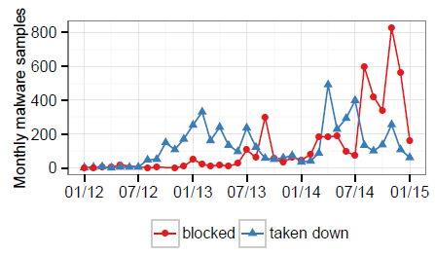
Evaluation
Actions taken against malicious extensions in the Chrome Web Store over time.

Slide 21
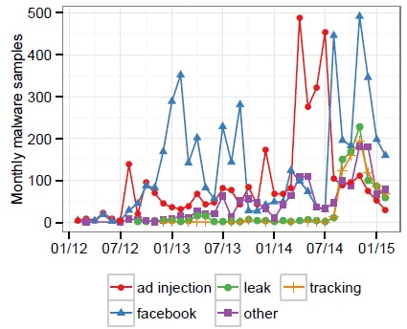
Trends in Malicious Extensions
Malware varietals detected each month from 2012– 2015.

Slide 22
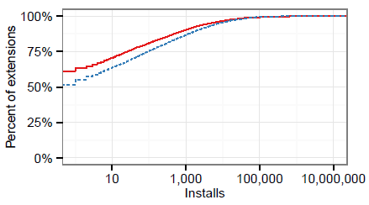
Trends in Malicious Extensions
CDF of installs broken down

Slide 23
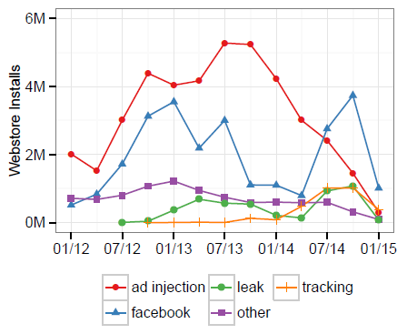
Trends in Malicious Extensions
Malware installations via the Chrome Web Store for the past three years broken down.

Slide 24
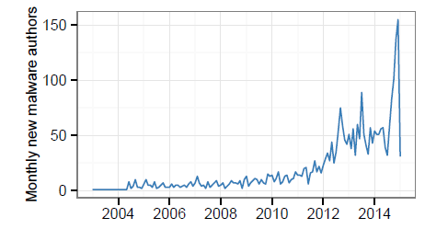
Trends in Malicious Extensions
Registration time of malware authors.

Slide 25
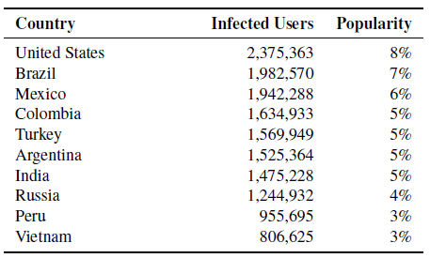
Trends in Malicious Extensions
Top 10 regions impacted by malicious extensions downloaded via the Chrome Web Store.

Slide 26
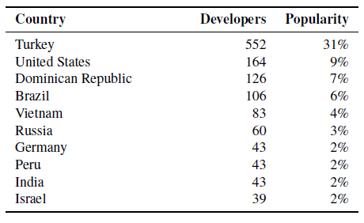
Trends in Malicious Extensions
Top 10 login geolocations of malicious developers.

Slide 27
Lessons Learned
The abusive extension ecosystem is drastically different from malicious binaries.
The importance of equipping an abuse prevention team with the tools necessary to rapidly respond to new, unforeseen threats.

Slide 28
Limitations
Dynamic analysis and security crawlers consistently run the risk of overlooking malicious behaviors due to cloaking.
The behavioral suites are not guaranteed to trigger all of an extension’s logic during evaluation.

Slide 29
Conclusion
They present a comprehensive view of how malicious extensions in the Chrome Web Store have evolved and monetized victims over the last three years.
They detail the design and implementation of our security framework that combines dynamic analysis, static analysis, and reputation tracking to detect 96.5% of all known malicious extensions.
They highlight the importance of human experts in operating any large-scale, live deployment of a security scanner to address evasive malware strains.
They explore the virulent impact of malicious extensions that garner over 50 million installs; the single largest threat infecting 10.7 million Chrome users.

Slide 30
Opinion
Human intervention
Policies

Slide 31
Quiz
Why aren’t traditional malware monitoring techniques effective against malicious extensions?
What’s the principle of choosing features for the classifier?
Why are human experts needed for their approach?

Slide 32
Thank you!

